Slide 1

Plant Leaf Classification
Inter IIT Team Selection Task
Made By- Deepika Sukhija

Slide 2

Table of Contents
Problem Statement
Dataset Creation
Building Model
Results
Model integration with Web Application

Slide 3

PROBLEM STATEMENT
You are given a plant leaf dataset and through digital image processing techniques you are required to do Identification of plants through plant leaves on the basis of their shape, texture and color features.
Further you are required to create a dataset using the extracted features to train and test the model.

Slide 4

DATASET CREATION

Slide 5
It is the binarization of image. First convert the image into grayscale then apply Gaussian Blur. This is used to separate the objects from background. Here, Otsu’s thresholding method is used, which automatically determines the threshold value.
Calculated features like aspect-ratio, circularity, rectangularity, area, perimeter.
Mean, standard deviation for RGB channel.
Calculated texture based features such as, contrast, correlation, entropy.
Morphological Operations
Target Labels
Shape, texture and color based Features
Thresholding
They are applied on binary or grayscale images to increase or decrease the size of objects in image. Also to close or open the gaps between objects.
Points_to_diff_category were made to distinguish categories, from them target labels were created based on the image name in the region it lies.

Slide 6

BUILDING MODEL

Slide 7
Step1.
Data Extraction from created dataset .csv file.
Separated Feature variables(X) and Label variable (y).
Step 5
Choosing the best model among all the models mentioned in step 4 based on their accuracies. Plotting a graph between accuracy vs models.
Steps
Step 2
Splitting the X and y dataframes into training and testing set.
Step 4
Building various classification models like support vector machine, KNN, Naive Bayes, Random forest and performed hyperparameter tuning on each of them using GridSearchCV.
Step 3
Performed feature scaling using StandardScaler on training and testing feature dataframes.

Slide 8
RESULTS

Slide 9

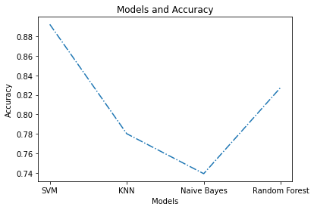
Support Vector Machine classifier gave the highest accuracy of
0.8922413793103499 AMONG THE OTHER CLASSIFIERS After performing hyperparameter tuning.

Slide 10
MODEL INTEGRATION WITH WEB APPLICATION

Slide 11
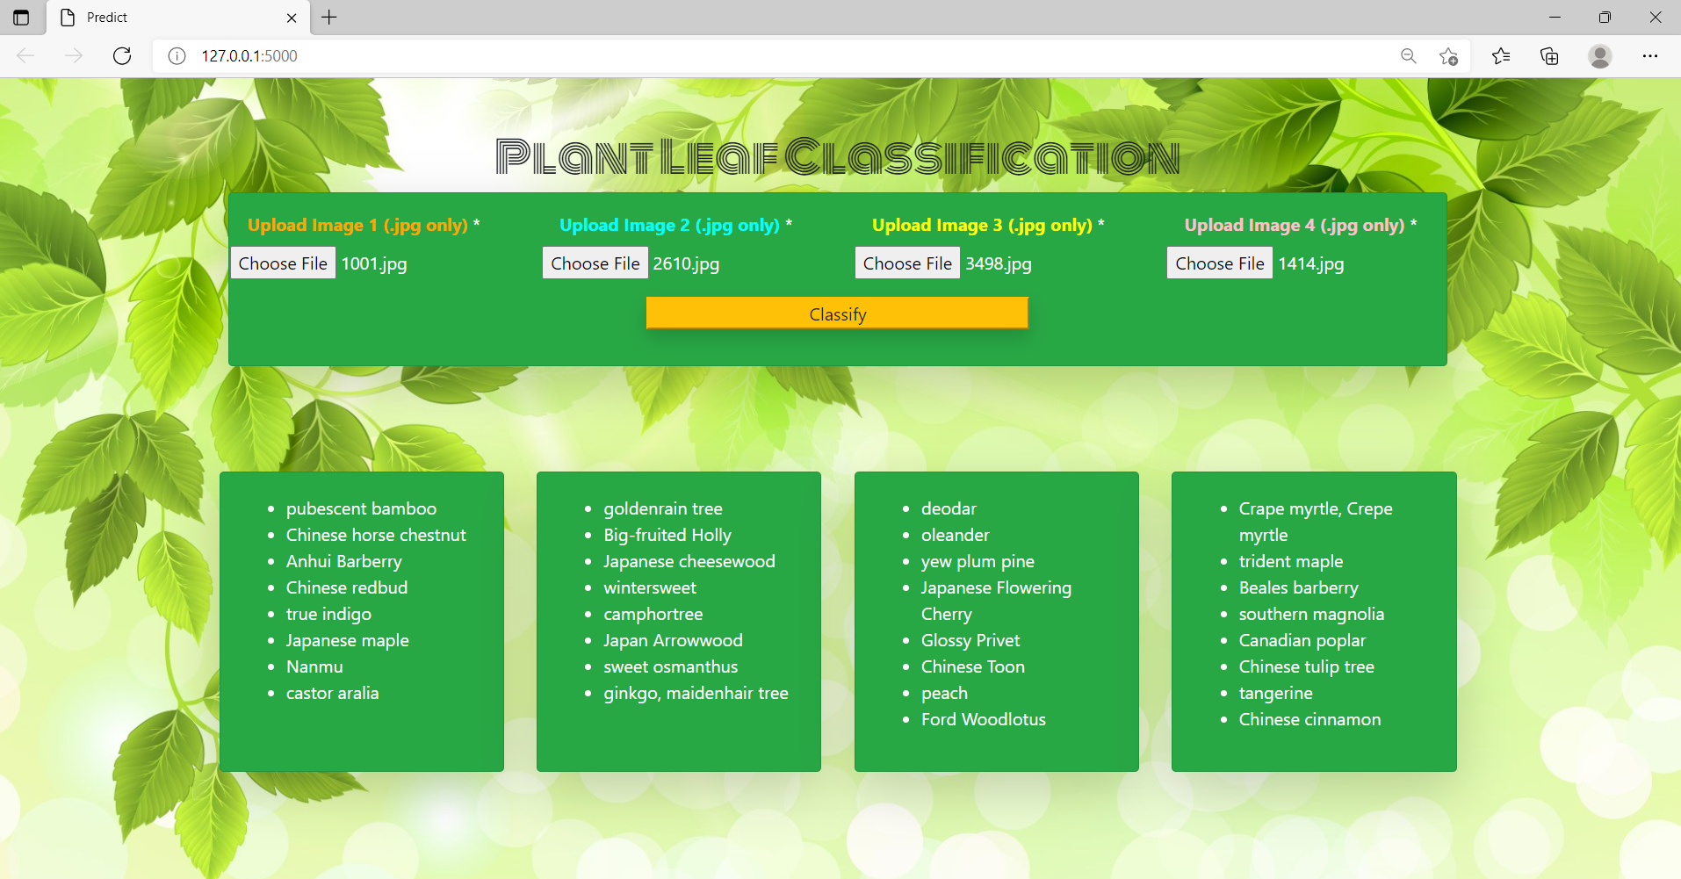
Before Prediction

Slide 12
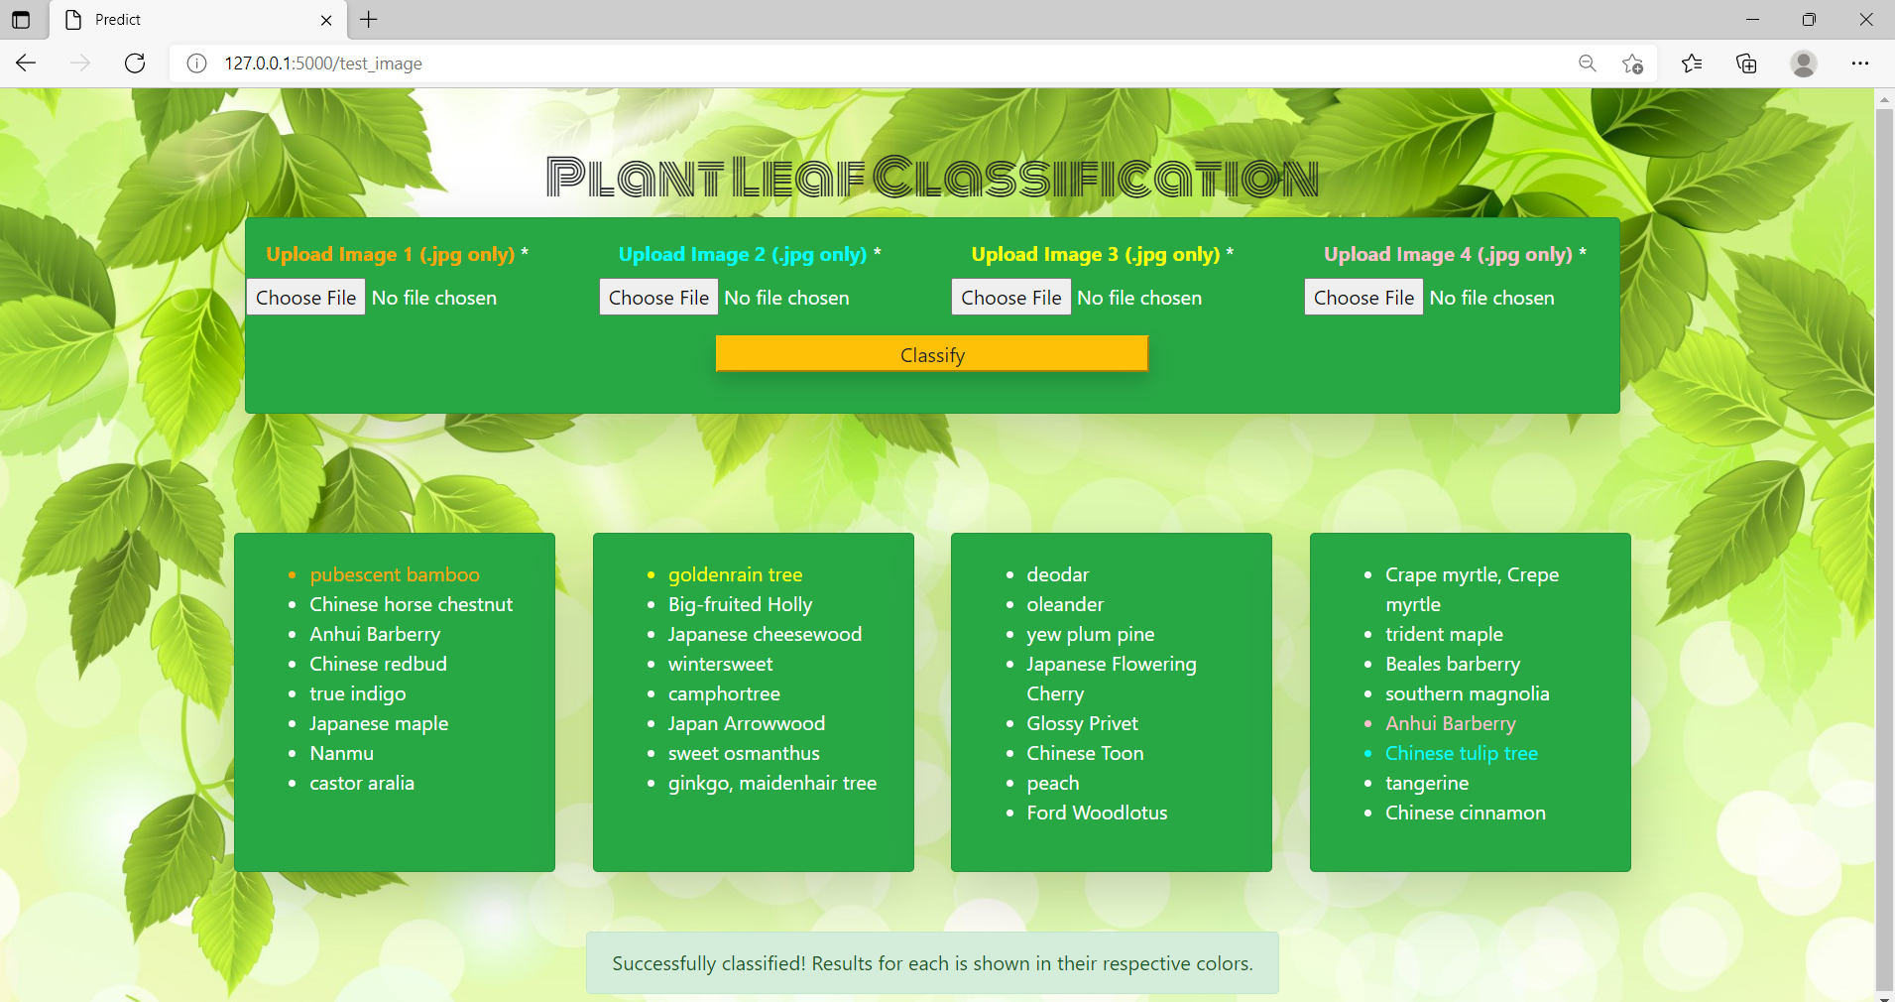
After Prediction

Slide 13
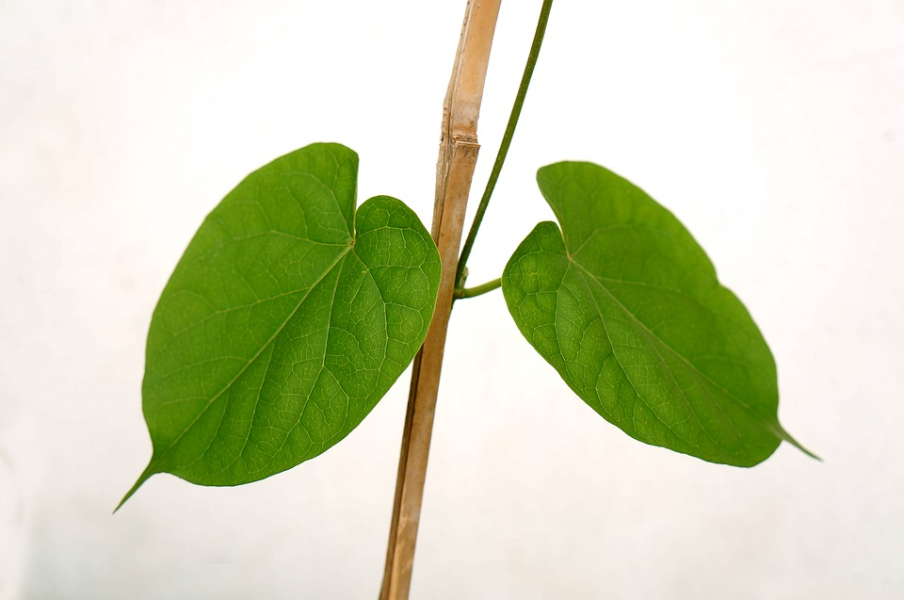
THANK YOU

